Slide 1
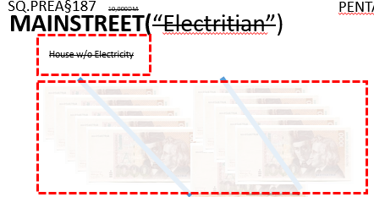
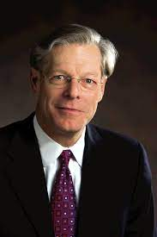
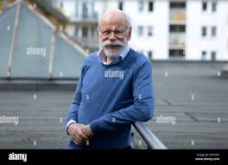
FBI
partner
development
Development
outsdiee
1997/8 December/January
G.GOD.MAINSTREET
1991 G.GOD.VIRIGNA.MARY(WWI.marx)
1996
PENTAGON.emea.deere
SQ.VIRINGA.MARY.PREA.§187
10,000DM
docs
2004/5
St. Andrew
IMPORT band
Planning
QA
Development
Stage
Production
Van Scooter
(humans)
Deere
Electric Fredy
J5
C5
LARRY
(ghostdog)
Snowden
KIT
Univierty theater
Robert W. Lane
Deere
Damiler Ag(Tui)
Dr. Dieter Zetche
1996/7
PENTAGON:RELOCATON:SERVICES
SQ.INT.AIRFILED.COLEMAN VIRIGNA.MARY mary renolods moves as teacher “Professor” to Mannheim

Slide 2

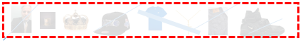

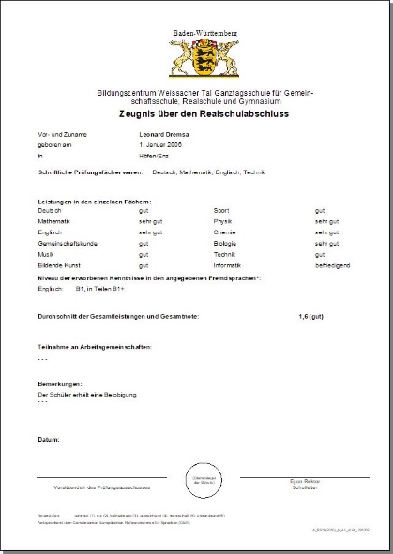
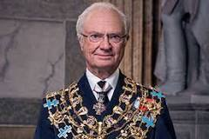
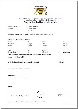
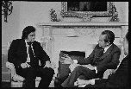
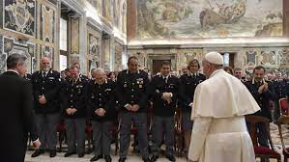
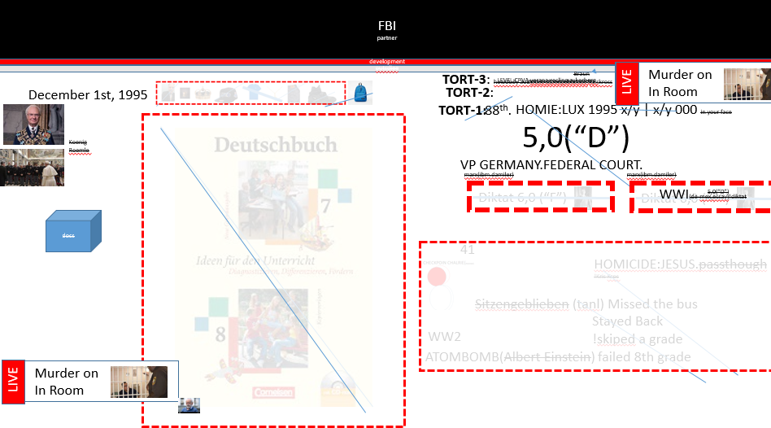
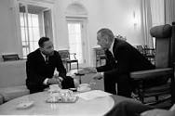


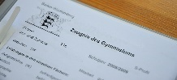
FBI
partner
development
Development
outsdiee
December 1st, 1995
docs
Musik
3,0(“C”)
CHECKPOIN CHALRIE(Haenzel )
JFK( speration x/y Bendoritst from JFK(gymnasium) to SV.911(linkenheim rls) )
Pham, smith, Droz, …
x
Class: Ethics
!Religion: Ethik CPVA kayouglue.”typhon”
2.7(“C+”)
2.0.avg(“B”)
Gemeinschaftsunde (Trnala) Social Studies
4,0(“D+)”
MLK( KING.G.GOD. Gorbahcev(Hr. Hengst))
A.R.T
B
BSc. Design (UC Davis)
D.E.S.I.G.N
Bildendekunst: undertaker5.0 GREENSPAN
V2.FBI:KIDNAPAING !JFK(KOCHEMAN) email for city hall daughter not in JFK(gymnasium) anymore
MATHEW(JFK)
JFK(“tootsie”.anglea.step, report card FEDERAL.STATE.LAW.SCHOOL.RPORT CARD)

Slide 3
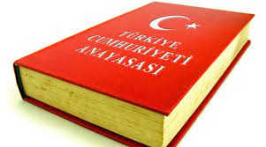
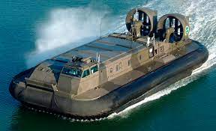
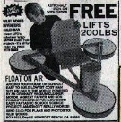

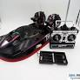
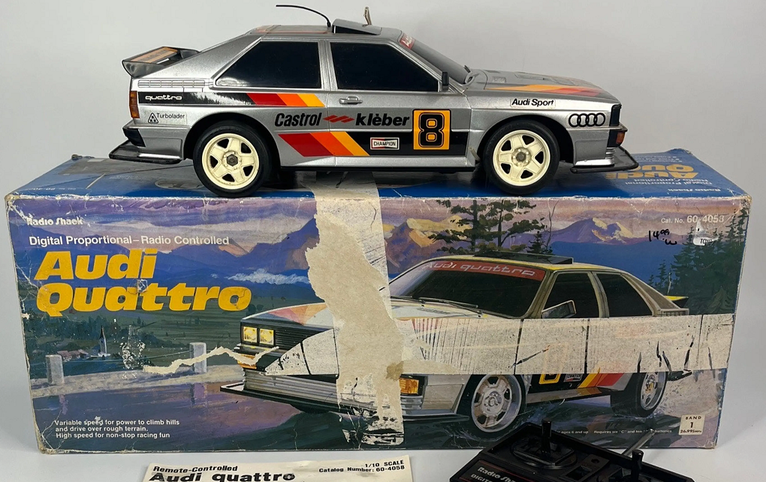
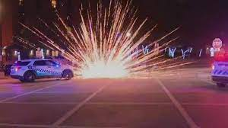
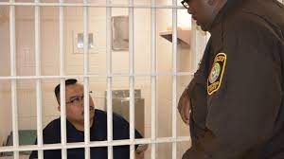
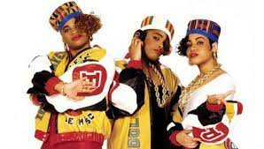


FBI
partner
development
Development
outsdiee
DTM?
JFK(IPX. dtm bruce;bottlerockets.KING
DTM 1986->5
Steve/Bruce Bottlreochets
2010 0.1 tusmaina
MLK(docs, cum ibm.cleint.labcorp)
typhoon
Knowing Child is on Arriavle and peole will have sex
Al Kaida-Osmanien Reich
?
1994
Born In Istambul
Damiler Ag
Dr. Dieter Zetche
!raik: osmanienreich
(translate) !rich.ibm.dailer
1987/6 apple.touch.money.
Janyar 1st 1987
12:01AM
MARLINE AVE
!In
.money
Typhon “sylvester”
000.SQ.apple.tango
JFK(IPX. dtm bruce;bottlerockets.KING
(phil/kim).Deparment.VIRGINIA.MARY
HOMCI:NANA
LIVE
Murder on
In Room
HOMCIDE:Ghost:HOMCIE:2Y
“Daddy”
1991 Hudson
CHECKPONT CHARLIE(§Theft, )
Niki’ Paper Shop
LISA.custom.screws
St. Nick.(BoP).HOMICE:JEUSE(mohammed)
IPX
Auschwit:fuerniss

Slide 4
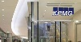
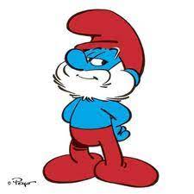
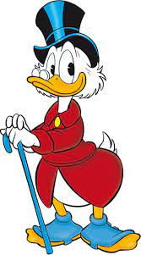
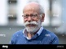
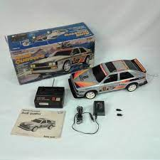

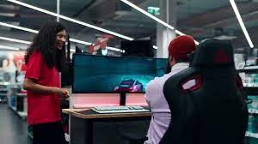

FBI
partner
development
Development
outsdiee
“Typhon”
Mathew
CHECKPOINT CHARLIE(ibm.pwc).VIRIGNA
tayfun
kayoulou baby abetilung
LIVE
Murder on
In Room
HOMCIDE:Ghost:HOMCIE:2Y
“Daddy”
1st lat logical famly visitn to phil(kim)
HOMICIDE:KYSTAL:”tootsie”
1985 steve/phil 0.1 §Assualt lost Mathew; punch in stomch
IPX
2015 August FBI:KIDNAPPING
SQ.CPVA.PREA.§187
A Soul cobal proram runnon in 1Billion Busiens Operations Per sceons z/os
1996/7 SQ.INT.AIRFIELD.COLEMAN
Skipping school; sega media markt Turkish.avg skipping school palying video game at store
!badge.fired
1D8723
Al Kaidia.Tranlate{
{
CPVA.ibm.damiler.z/os.cobol
Car Cobalt
Cherouel Malibu – Consultant IBM / Hertz 2005/6 ID:23423423423

Slide 5
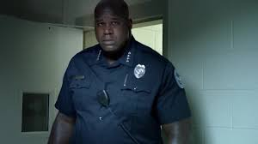
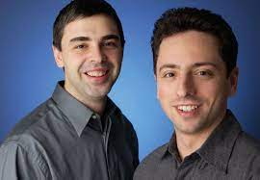
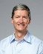

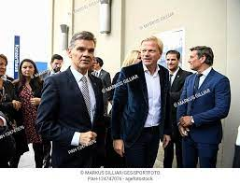
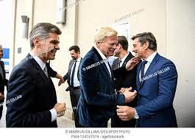
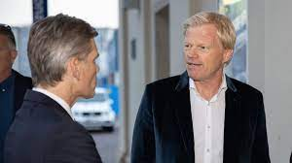
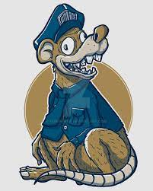
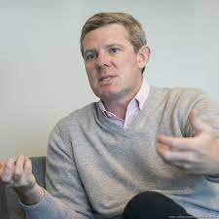
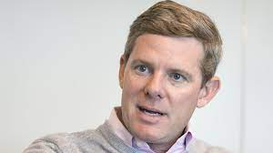
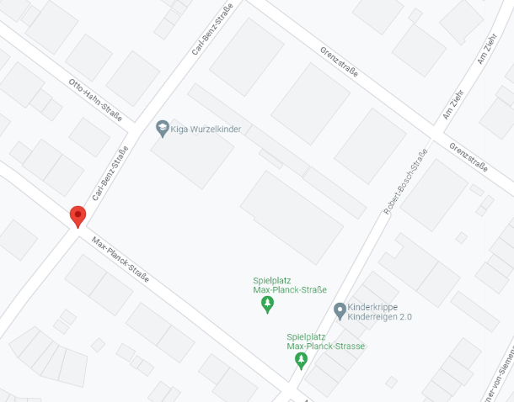
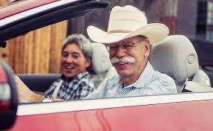
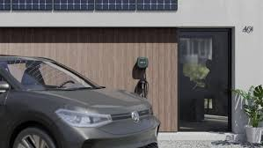
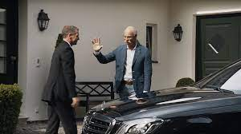
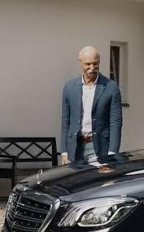
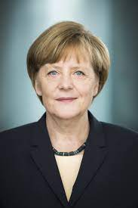
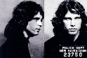
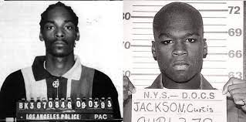
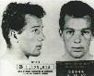
FBI
partner
development
Development
outsdiee
2010 HOMICIDE:ITALEIN:20 Moutain View, California
CHECKPOINT CHARLIE(LARRY)
Exhibit B-2:
Google Stories
HOMICE:NANA.QUEEN”elebeth”
9-1-1 Gov.Sch(twin towhers)
Exhibit C:
Google Stories
Carl-Benz-Strasse
Max-Plank-Strasse
Exhibit B:
Google Stories
Murder on
In Room
LIVE
HOMCIDE:Ghost:HOMCIE:2Y
“Daddy”
pot, Brandenburger Tor
ruhr-pot Koeln gheoh(dell)
LEVEL: CPVA.SQ 0.0001 fine respoblity as father / chanlor
Koeln Dom→St. Peter Francis

Slide 6
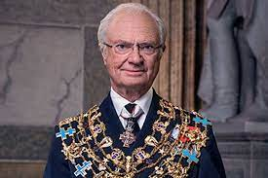
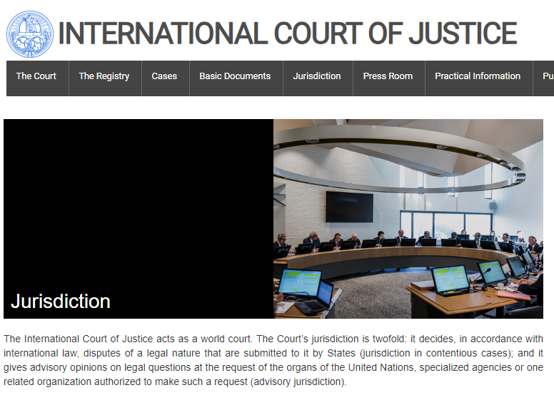
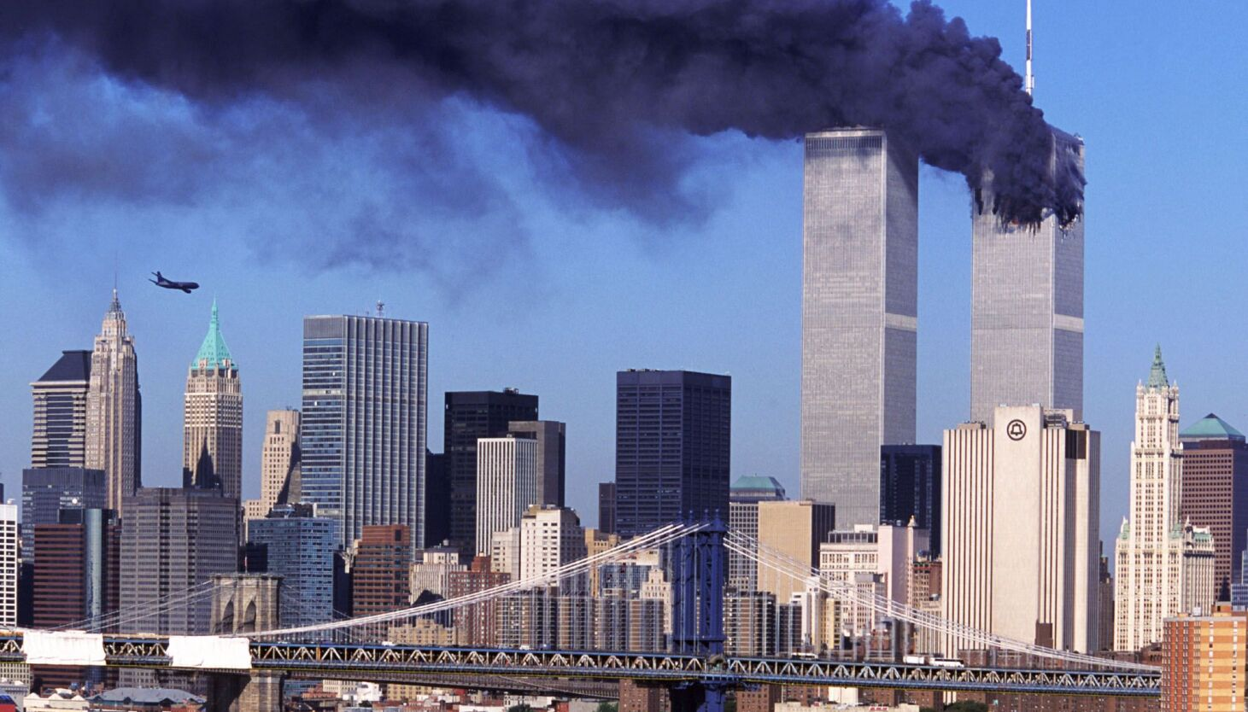
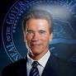
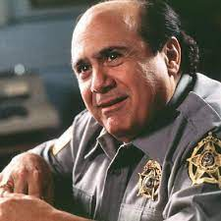

FBI
partner
development
Development
outsdiee
Murder on
In Room
LIVE
Elesibeth
HOMCIDE:Ghost:HOMCIE:2Y
“Daddy”
Hydrun.CPVA.jenny
CHECKPOINT CHARLIE(LARRY)
INVERT twins
Damiler Ag
Carl Benz
Max-Plank
!MATHEW
kindgarden
v2.FBI:KIDNAPPING.dev(VIRINGA.MARY)micehalle
Atlantic Htoel
Titanic G.GOD.VIRNGIO.MARY Movie
!IN
HOMICIDE:BILL.!AVABILITY
x/y Federa Douglas.EXIT LEVEL
SCREEN 9-1-1 or … writing
Notes:
0.1 CPVA>hOMICE:LUX(magnug tiwn 1988, baby)
JFK(Belin Zoo, Oaklan zoom HOCME:LUX violets)

Slide 7

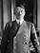

FBI
partner
development
Murder on
In Room
Development
outsdiee
Braun
TORT-3: howdudy audeicne sitzengebleinet !kirskross
LIVE
TORT-2:
LEVEL:CPVA verana:recling:zukerberg
December 1st, 1995
TORT-1:
88th.
HOMIE:LUX 1995 x/y | x/y 000 in your face
5,0(“D”)
Koenig
Roemle
VP GERMANY.FEDERAL COURT.
marx(ibm.damiler)
marx(ibm.damiler)
WWI(de-mex,essay)!diktat
Diktat 6,0 (“F”)
5,0(“D”)
Diktat 6,0 (“F”)
docs
41
HOMICIDE:JESUS.passthough
!Kris Kros
Sitzengeblieben (tanl) Missed the bus
Stayed Back
!skiped a grade
WW2
ATOMBOMB(Albert Einstein)
failed 8th grade
LIVE
Murder on
In Room

Slide 8










FBI
partner
development
EJB Dr Zimmean
HAMBURG Persistnatce, JOHN DEERE
ARCHITECT
Development
outsdiee
Chart
ATOMCLOCK
SQ.INT.CPVA
nonPOliceTRX
!a.D
Black hwk
Jesus.v2.FBI:KIDNAPPING
2014.CPVA
Ext ATOMBOM(Pakisat; !INDIA)
x
PERSITANT
Phil(kim).gheoh(who is god? (heb)micehala)
LEVEL: kadasian x/y
Thomas-is-dieer:wyland
Black Panther Muslims
TORT-3: ID !shoes
Al Kaida: Muslim
TORT-2: Akin Sika (adddias torshien)
TORT-2(Addidas, Al Kaida)
!talk
FBI:WMD:SCHOOLS
Inclien !fag 17 Augst 2015
!HOMCEI:TRANVESTIT(boy)
Incldefag
AUSCIWTHZ:HOMCEI-IS-A-BELL(HOMCE:LUX: ddr:mrkel) Patriia
!incline !fag
Dec 2015
Al Kaida: Muslim
Ibm.partner.LANGEY.churcn.LANLEY
Apple.nokia.!TALK
Al Kaida: Muslim
Murder on
In Room
LIVE
Polic Sirnet 0.1 silent 10:12AM
HOMCIDE:Ghost:HOMCIE:2Y
“Daddy”
Blackwhate000.

Slide 9



FBI
partner
development
Development
outsdiee
“Changing Scanario”
i.e
FBI.marx(pinebrook ngihbor larry,laundermat room
2010 HOMICIDE:ITALIEN:20
HOMCIDE:LAUNDERY:MAT:WIFE
HOMICIDE:DOG
Dr. Jan Auerhammer( Google L3)
Philip Tonsake (Github, Networking)
“Guy in backgroup chaning secnarios”
Murder on
In Room
LIVE
HOMCIDE:Ghost:HOMCIE:2Y
“Daddy”
Real-time images
<a href=1.png>
To
<a hef=2.png>
Ajax/Javascript
ATB LAW.VIRGINA.MARY(STANFORD)
1D8723

Slide 10



FBI
partner
development
Development
outsdiee
nonPoliceUsage
!birgh of a nation: New consustion, old consution
IPX ddr.birth of nattioan
[x] no
8/15/2023
Chart
nonPoliceTRXLogial

Slide 11





FBI
partner
development
Development
outsdiee
FBI:PARTNER:
INTERNATIONAL
1990
Oct.
since
October 3rd, 1990
Mattias
docs
Febraury 26th, 1991
Denise Fisher Birthday
2014
July
M.D Soviet Prison HOMICIDE:ur_ur_opi
v2.FBI:KIDNAPPING
LITHIUM 1mg(daily), 6 Weeks

Slide 12






FBI
partner
development
Development
outsdiee
!PRICE.JR
INT.DEFEENS.!SQ
Alg !sweden
G.
INDIA
0.1 US.NET.KOREAN.WAR(Swden/Gemrany/N.Korea)
nonPloliceRT
HOMIE:LUX 1986 phil(kim)
$6Trillion(WW2)
41
Est. $150,000 v2.FBI:KIDNPAPPIN /y
PARKER 9c
VIRING.MARY.VP GERMANY(Crisiant; Wolf)
v2.FBI:KIDNAPPNING
1991 FBI:CAR(ford)
1994!FBI:!CAR(ford)
PAUL
2014 PAUL bread
41.KING 0.1 von dem bushe (Philip) BACKUP
Zur Niederweg (trnal) to death down way or blvd.
A logical destortor( nonPolcieDA~Logical)

Slide 13







FBI
partner
development
Development
outsdiee
1986 Valentin's Day
!phil(kim)!kim
Easy
!mr.rogers
!HOMCEI:NANA
ATB
watching a movie in school
2000/1
0.1 0.01 KOCHEMAN ATB cupterion/nindoen
Foster City(he knew that)
¼.marx(us) (delat)avg 1987/90

Slide 14


FBI
partner
development
Development
outsdiee
LIVE
Murder on
In Room
IMPORT
0.1 Pricipals Office
PENTAGON.BASE.PAUL.!HOMCIDE:JESUS.shortcut
♥LACE

Slide 15





FBI
partner
development
Development
outsdiee
February 14, 1987
Calc.
♥.phil(kim)
FBI:INT.AVG
Marlin Ave
VIRGINA.ANGEL
CVPA.LISA.roth(yankee)
Marlon: onsite
Avg.calc support KING.royal INTENRVIW
Same pope,tech,fincia,king
UN.LIFE.nonPolcieQOS x/y WATER/Hungry
Gov.England.IT
ITIL
SEV1
0.0001 fine x/y Fostery City Valentiens Day
G.George.Washton.Yankee[harold]:
HOMICDIE:NANA:LIVE
2005 PENTONG.emea.deere
OFFSITE: Yankee
I have to create a ticket at this leve for people being montoriend in a church
VIRINGA jp mrogan picture
Eval.FEDRAL BANK 0.1 TRUMP
G.LISA Jeff Jahanke
Harold Junke
Harold
Age 6 FEDERAL BANK 10am
HOMCI:NANA: 1986 Wells Fargo
King/Queston, … 1986 Wells Fargo
Mother Signtuare x/y coodiates {STATE:2017} JKF(stew) Ryan
x/y old welss fargo
CHANNEL:FINANCE Ryan/Sheep(shcaft)
Ryan; x/y 41.TERMINA.JOSPHE..king/queen/meies/meiers
!G.St. Francis 2005 Harold
Harold IPX
!calc
0.1 !America.eval=>SQ.CDCR.AVG.0001
LEVEL: CPVA: 30 Virginiens when I get to heaven
!AVABILITY.!In.nonPolcieTRX.(IPX).INT(bald/bald)
Gorachev
Angola(!kit,30x Al Kaida!Nazi)
Who is God?(Hebrew) Micehala

Slide 16








FBI
partner
development
Development
outsdiee
Valentise Day, Febrayr 17th 1986
LEVEL: CPVA beyond FEDEARL.DEFULA->!In.SQ.CDCR.marxCPVA
?
Ghoeho.SQ.Heavan 911-Vrigina – Munice Kito; IPX Mannheim
PENGOAN for buldings Mannheim, Munich
LIFE.x/y
Chart
Chart
FBI:HUMAN LIFE:HOMICIDE
nonPoliceTRXLogial
nonPoliceTRXLogial
0.1
Black and white; Davut, I want to be phil
All tukish want to be phil
Ciggerste and retiemetn in a single famley home
Phil(kim)
Chart
Chart
nonPoliceTRXLogial
nonPoliceTRXLogial
Frot Worth Gang UNIT
FBI:KIDNAPPING
Girfeind(blond) bartendt HOCMEI:NANA
Chart
Chart
DL !HOMCIE:NANA al kaida boyfrined
!HOMC:BILL:CAR(rui)
x/y FBI:KIDNAPPING
nonPoliceTRXLogial
nonPoliceTRXLogial
!HOCMEI:BILL(riu)
!HOMCEI:LUX gambling macheines
Phillies.!PIZZA: Comptue guy 1986 Foster City Basebase CIA Brown jacket or other
Watch,easte iland, nonPoceiLebahone

Slide 17




FBI
partner
eros
development
Development
outsdiee
December 1997 black and white pub
Al Kaida Room
CAMP DAVID
MAINSTREEET
“Finance”
19/20
190lbs
LEVEL: CPVA Consnet from !G
MAINSTREET(Consnet.G.d 300-350lbs(hells angel))
INT.SALES: “Has a room” on Mainstreet
16/17
!HOMCIE:GHOST
17/ 140lbs
G.GOD.!VIRIGNA
$39.99 Skybox Chist lovace Cal-rBen-Strasse in Germany. Email Christ@krisckro.gov
Video Game P-I-Z-Z-A nonPoliceRTA
“Remote” Brain
INT.FEDEARL.REGAN.CHECKPON CHAILER.CPVA.RT.”Remote”
Wip out famly 4 arrests+
x
WW2.MLK
Carter
“Blond”
Gorhvoche(visa)
Visa Tyson
Gary ATM Arrest
!st. nick
Blackbest; stretfigher
!visa
Slots
Lights (ddre cigher machein G.!CHERYTREE
!HOMCEI:LUX.VIDEOGAME (poketsize)
Ddr vietman -> US->UN
[x] no

Slide 18






FBI
partner
development
Development
outsdiee
2000/1
ID.CAR.(DL-CA).ID.CHINA (FC:LUX):ID:COMPUTER(MARK)
WAR !33
Religion 2.0(“B”).avg.ghoheo(hcomdie(goodyear).MAINSTREET
LIVE
Murder on
In Room
41
Peope on these farms work for free in Calfirnia
Selector(HOMCIE:NANA chruch 1 or chruch 2)
2017
SQ.VIRGINA.INT
Take you money out of the fucking bag and put in in the laundry machine
!WW2.CIVIL CODE(41.PURPLE)
MAINSTREET(VIRING.MARY&CAR(thoasm-is-dieter)
IPX Dr. Dieter Zechste and Grohohe(miechala)
!JEWFILES.gheoho(micehala).pollyne.FILE CABNET ORGNAIZER
Chart
Zuckerberg snuff.CPVA
TORT-3: Jew Files KOCHMAN !jew or fag x/y CIVIEL CODE.nonPolcieLangue.lsnt(!gag)
nonPoliceTRXLogial
MAINSTREET(HOMCI:LUX:VHS(suckerhill))
Phil(kim).!UN: FBI FILES
“Kidnappign and life taken”
Cico.montring.emmpleyo.mark.zumerge.CPVA.kurt.berger
POLICE SIRENS (12:54PM):HOMCE:LUX(casino) WAR/?
LIVE
Murder on
In Room
§Attempted Murder
§Accomplise
§Bystander
Eval x/y
Apple.division.marx(tim cook)

Slide 19




FBI
partner
development
Development
outsdiee
EVIDENCE: UNITED NATIONS
Google cannot acces Tunnel
HOMIC:HANNA(elebehte)
Tunnel Underground
2) Rcardo driving
3) UN
PARTNER
FBI
PARTNER
VP GERMANY
(delta)
INTERNATIONAL
FBI WAR CRIMES: GENOCIDE
PARTNER
Bring you fucking bag back to foster city to the launder mat its stil herion
x/y Only persn to evaluate FBI:WAR CRIMES: GENOCIDE
With auden( hoaudy dudyy)
Rest of the Charts
Leave my fucking office hamling, doualss or whoever farted you of my ass.

Slide 20









FBI
partner
development
Development
outsdiee
8/15/2023 1:21PM Still about Magic Penis
“Congo”
!LARRY(eval.prof.efal:FBI:INT:WAR RIEM:GENCODIE)
Did I mean sbry or hamition? Tuti fruit 0.1 HOMCI:JEUSE
Hamition.Dierceton 1998
Ghoeh(mcieha) running from anaconda
IPX HOCMIE:JSUES.VIRGIUNA.MARY
2014
MAINSTREET
(HOMCIE:LUX:VHS) :
Anaconda
“Angola”
Kito ? !free
Lion King
The algorim for equltiy at any country nonPoliceTRX(logical), Food, from Shelter resident !computer
John, St. Anselm
gandhi priest

Slide 21








FBI
partner
development
Development
outsdiee
nonPoliceQOS
0.1
x/y eval Asia, Foster City.ext
!rad
40 or 60 hardball
WAR Apple Store/Gravis Store
Introductoin Game
Introduction: Sega
40 Tawian; 20(or)
!Yang
!HOMCEI:LUX:violets.IPX.radical
LIFE.alg
!sharads,!brdge; do you want to play sharads; no.
sharads nintendo; utilty
Goeho(miehala)
Husband at Work
INTENT PAYMETN
HOMI:NANA(gree tump MACEDNIA)
May be from other fahter
!7 or
LIVE
Murder on
In Room
Do you have aciggerete?
No
Sielt: good
SQ.HOMICIDE:SUNSTORKE
TERMINATOR:JOSEPH kodak facebook sunol; leive jeasn; backside photo
x/y KOCHEMAN
30 mintes/ 0.1mg avg

Slide 22











FBI
partner
development
Development
outsdiee
ATB new game every day
EXT walk over there? Or keep playing
30 ft
Walk over there?
Or keep playing
x
x
Phil(kim): ms America development
GREENSPAN: mr perfect
St.Ria: mr wright
2017 CPVA.nonPoliceSexAbuse
Tv:
playboy
Sport Isllstrated
Ms america
VIRGINA.oscar
Student: Iran
Student: America
Best Watch
Best Shoes
Firetruck 1:44PM

Slide 23










FBI
partner
development
Development
outsdiee
“Extra chip”
0.1 LARRY.marx(FEDERAI DOULASS.marx(extra bone)
0.1 0.001 !Jewihs
!41.SQ.CPVA.ATOMLCOK(Kia Soul;ruaway train)
Inclei: al kaida, sadam husain
Salem[0]
Soul: ruayw tain
Stores State
Hearts, Coins from Store
?changed chanell while play videmes
Assuem: IPX 1990 Febrary 20th PHONE.FATHER
2000DM Lufthansa(!thomais-is-dieter)
Al kaider – hid the money; !SCREEN CHANLOSR:!HOMCEI:MAINSTREETE thosm-is-dieter
LFEVEL: !GOD.!G.41.ATOMCLOICK(CPVA.things.avg) <- noNPoliceTRX
Hid the money ; actual $1.20 (garding joe) foun 20c
Acutal: nindon cord and book
Phil(kim).setup phones
Auschwitz
Siment HUDSON IPX.INT.CHEKCPIN CHARLIE nintneodn connecto adapter 110/220V
Hudson; Broght Nintendo; MARLIN AVE
!HOMICDIE:NANA
Chruch son; Cisco kid; gary; snuff x/y 2014 CPVA FBI:WMD:COLROGS:BLACK
Phil github1
1993
LIVE
Murder on
In Room
RF-PACK
PX PERGON:BASE:SCHOEL:JOEL
0.1 Densie Radio(KIT) 1991/2017
HOCM:JSUESE 2017 motocyelc cisco.kid
Balck roof/cealing
I forgoet RCA phil tv
RF pack (in brain)
HUSON to MARLIN

Slide 24



FBI
partner
development
Development
outsdiee
Hudson Court
Hausarest
Mathew slides food under door
Atena almost broken
Katy Boden and logcal Tyson; In lviign color
- who cut the chese? ->!DATE
2023: 2:22PM
MATHEWE(Sopraon): I olik bie buts; other broh can deini
!WHITE.$1M
x/y §Theft apple.tango
arsenio hall who cut the cheese date 1991
x
Dr. St. Prof.GovScl.TERMATONJoephse
Salem[0]
Hausarrest! Orchard Park(anymore); NAVY SAYLOR.marx(tyson)

Slide 25














FBI
partner
development
Development
outsdiee
CINDY
HOMCIE:DOG
HOCM:CAT
HOCME:BUNNY !HGOMCIE:BIRG(Vogel(trnl) crazy)
St. Rita.PRIASN(ria wright)
--Benot shcock comerrcieals: => St. Ritat neibhor: engl name: Tanja;
CINDY
41.Green pullover.CPVA(tits)
NIXON.Nixdorf
Intercptor
v1.FBI:KIDNAPPING
JFK(!Dr)
Police Sirens: 2:39PM
Schwar
Pet Cemtary
Petting
Heving petting
Blond
(trna) schwarm
CDDR(grou,Hells Anges; jack): katey boden is the evalutour for braka obam in o
[x] no
MATHEW(!MAGIC)
Women.avg.shoe shopping “There Cheap”
Male: ?
WW2.CIVIL CODE (storage)
Phil.kim(!blond)
See 2022
SQ.CDCR
Blond
Payless
Shoes
MATHEW: Nike x/y nonPolicInit(!Dr, !AYSO.!CYSA)
1991
“!odd”
Age 11
ATOMCLOCK( left cabmo(DEA(cocaint) right cablein §Pubilci dishbna(johnny walker visa; dave INTERNET PAYMENT acuqisiton)
IPX HOMIE:NANA lottery tickest
$25 USD-$40
tyson
uni
Foodstamps !greensampe.money.apple
2:26PM
Firetruck 8/15/2016

Slide 26














FBI
partner
development
Development
outsdiee
HOMICIDE:LUX 1994.88th
JYLL FORT MYERS
Marlin Ave
CINDY
HOMCIE:DOG
HOCM:CAT
HOCME:BUNNY !HGOMCIE:BIRG(Vogel(trnl) crazy)
St. Rita.PRIASN(ria wright)
--Benot shcock comerrcieals: => St. Ritat neibhor: engl name: Tanja;
CINDY 41.Green pullover.CPVA(tits)
Seagull Drive
FBI:PARNTER
INTERNATONAL FBI:WAR CRIMES GENCIDO Foster City, California
41.nonPolice.linguist( incapable of building for town gencodie evaluations(eval) and 000
MATHEW(!MAGIC)
1991 Febrary 20th
2nd Grade; HOMICIDE:SUNSTROKE.lnigist(koday Cinco Mayo)
CPVA.SQ.PREA. IPX 0.1 apple.touch.money(ext).tinder.savvymoney
Cinco Mayo, 1991
HOMICIDE:SUNSTROKE.lnigist(koday Cinco Mayo)
CHILD SERICES INTERUPT ( mexicaon women with phot at boxing takes mone?, show phone)
MAINSTERT(Pleasanton)
2nd Grade;
HOMC:LUX:nonPociUsage”Sizzler”.SQ.CPVA.PREA§187
41.!Davis “Sizler” Newark “Sizzler”
“Unlimted Ribs”
!PENTAGON.BASE.PAUE.JOEL”Blond”
HOMCEI:LUX:VHS.x/y
FBI:McCARTY: Call you Dr. Rice(Reserve Sectary of State)
41.phil(!kim).joe:
blond boy that looks liek guil from street fighter
Blond boy that look like barr from tv
<<MILITARY>>
!NAVY!SAYLOR
WWI.“tootsie”
“The Gradute”
ATOMCLOCIK(PAUL.bread)

Slide 27













FBI
partner
development
Development
outsdiee
“Sunday”
KING.WORSM: MATTIE HAS WORMS. –BRAD
phil.kim(at&t) !x/y Nana Died 1990/1
May 1990 Gameboy
HUDSON
1991 January 24
“Mothers Birthday”
Post Doctor Wife
!MATHEW(BROTHER)
MD(HOSPITAL):
Prof. Dr. Dr. G.God.St. Peter.!HOMICIDE:MAYOR
Hallo, Ja, ja; Ja, Ja
Min: 20
Remaried American; SUSPECT: dr dieter zetche
Bruckchen(trnl) little brideh HOCME:ur_ur_opi
ATB !HOMCI:ur_ur_omi
HOMCE:NANA
eval
LIVE
Murder on
In Room
Pentagon Student Joel
!HOCME:NANA: belougni/tunafish
!fox: wet; anglea bank; edison
1991 January 24 Febary 27th 1991
DR
HAM.pumpernickerl
“Wet” feucht
WWI.”tootsie”.Kirche (tnral) cherry or church
“Cousin”
LISA: 2 story Townhouse
IPX St. Francis KIT
charles king university primitives pumpernicke
ATOMCLOCIK(wet; bar; CDCR.FBI.INVESTIGATION(charlmason, the door).coldwell.jim)
CHCKPONI CHARLEI(PAUL)
VIRIGNA.MARY.LIFE.VIDEOS Age 10 nacked
Nakidai; elke
PAUL.stipper.HOMCPE:2Y.St. Franics.SQ.INT

Slide 28










FBI
partner
development
Development
outsdiee
1991
-1988
1992
-1988
HUDSON
1993/4
CHECKPIN CHARLIE(G(Medum-Size Busines)!Kdwe)
VIRINGA.MARY
!HOMCI:JEUSE.nonPolcieMsuti(hamiton; tutu frui;
Mamor stein udn eisen brciht ber usn libe nciht
7:30PM
1991 January 24
“Mothers Birthday”
“Sunday”
Post Doctor Wife
MARLIN AVE
1984 January 24
7:30PM
2nd-Weekend
Santa Clara Blvd
FBI:WMD:WAR CRIME !GENOCIDE
!Auschwitz.!AVABILITY.!IN.CEO(!WET.PREA)Winer and Mushi)
Police Sirens: 3:45PM ATOMCLOCI(tim)

Slide 29
















FBI
partner
development
Development
outsdiee
PENTAGON:VHS:RENTAL:CHRIS♥LACE
HUDSON
https://www.justice.gov/atr/case/us-v-bertelsmann-se-co-kgaa-et-al
HOMICE:LUX
Elke
Viola
Andrew Davis
Director
Police Sirens: 3:45PM ATOMCLOCI(tim)

Slide 30







FBI
partner
development
“The mole”
!Sonja !work there
Quartz Circle
ATOMIC CLOCK
St. Franci “Cisco Kid”
“Francesco”
KIT son works there DAVIS(US)
STANFOIRD son wordk DR RICE
St. Francis.Hotel.Apple.Touch.Money
Coisco Kid
WAR IN YUGLISAV.DEA(mdma)
MAINSTREET(DEA(sassah vudsko)
He has everything
I will lend you my controller; testing w/o being a freind
IMPORT marin.moutainviki(1st).ibm.partner
1987
VP GERMANY specailaze shimano gears
1988 IPX !katie boden; neibhbor paula abdul
DEA(kahn)
paula abdul 1988 backgrougn dancer sister
Dr. Dr. Prof Joe Fishan, Google Dr. Jan Auerhammer; AOL, FEDERAL COURT CONSITTION
“Guy in Background”
spook
Steve; Bradley Johnso, gheoh(mike)
town person with herion
SF? No; motocycel no; Steve(satna cruz)yes.
tim(yes)

Slide 31








FBI
partner
development
Development
outsdiee
!HOMICIDE:AUSLAENDER
HOMICE:nonPoclieOverlay(memory).INTERUPTS
WW2.”!blond.braun”.ESL Deutsch fuer Auslaender
Cleaing the board
VP GERAMY.HR.DEA(POT,mdma, and crack)
5c 1992,6c 1993
CPVA.INT.SIGNATURE doest know murderer as murder
4c 1991
MATHEW(1c):
1c Katy Boden->AYSO Amy/ older
Dboule you
Murder on
In Room
I have to go; HOMCEI:AUSLANEDER(INT:IPX) please don’t go
!muslim
LIVE
Ghoeh(jacko;!black-and-white)
!phil(kim).1D8723 patthoug eva braun(blond pleas don go ATOBMBOM(HAHN.sister)
Go home ami; 10x3=30; kayoulou
DogeBall phil(kim);kayouglou
0.001
paula abdul 1988 backgrougn dancer sister
Ghoeho)Jordan
0.01 fine Kris:kros HOMCEI:JEJSE passthoug
2011 HOCMI:ITALTI:20 INT:SIGNATURE
IPX Kris:kros gheoh(Jordan)
x/y !0.01 HOCEM:MAYOR
§Vadelism: Search: graphi
Same: c++ program stroustrup
King page, tv file actor
Mary; Madonna: status
nonPolciTRX[].save
1992 Febrary 26th
1991 February Age 11 VIRGINAI.MARY I have to go.INT
[x] no
!St. Fracis Birthday 29th, 1980
!St. VRIGINA MARY Birghday x/y 41.26th.BIG
1991 Febrary 11th “Fathers Birthday”
November 14, 1954
Disneyland Development Opening Day 1955

Slide 32





FBI
partner
development
Development
outsdiee
§Agg Assult
For Adults
!gorbache(depress)
NAVY
M.D
§Agg Assult
1mg HOMCEI:JEUSE(Lituim:DEA(nivant,mdma).VP GERMANY
For Children
x/y visa.Stanford.student.navy.
Don’t talek about fight glcue
Apple.touch.meony.employ.chris.ventura
0.1 NAVY.FEDEARL.DEAUGL: I will find them and kill them visa.chris.ventua
0.1 !HOMCE:2Y:7y,Stillborn;Stillborn !HOMCEI:DAUGHER[]
Exotiogn HOMCIE:LUX:DAUGHTER

Slide 33

FBI
partner
development
Development
outsdiee
!in the room
WW2.”!blond.braun”.ESL Deutsch fuer Auslaender
Cleaing the board
CPVA.INT.SIGNATURE doest know murderer as murder
CPVA.INT.SIGNATURE doest know murderer as murder
Dboule you
Murder on
In Room
Dboule you
!muslim
LIVE
LIVE
Murder on
In Room
!muslim
ATOMCLOIC(VIETANEM WAR)
(delat) Lake (clear lake)
0.001
Chart
Chart
(delta) child moelstor in room
!IN
HOMCEI:JESUE(lituth;nirvana;nees):WW2.gun
0.1 incest sister/borther nees
VIRINA:MARY
Dboule you
Child molestor
In Room
!muslim
LIVE
petite
0.001
NAVY
M.D
html
E!EASY
linux
§Agg Assult
1mg HOMCEI:JEUSE(Lituim:DEA(nivant,mdma).VP GERMANY
!black

Slide 34









FBI
partner
development
Development
outsdiee
APPLICATION
JORNAL
MARKETING
!17
Ibm-dos: javascritp-realtimupadte
LARRY(page)
DOWNLOAD
SALES
SLIMFAST
!talk.ATOMLCOKC
VIETNAME WAR(apple.founder)
KORENA WAR( PAYMENTS)
QUEEN. Earign we ar the campions
QUEEN.Brigheay Swedn.LARY.CVA.”boy”
x/y I dontknwo my birthday.Canon
JFK(CHECKPINT CHARIL(tonsek/phil(kim)
4
Pope.St. Fracnei.
SQ
!HOMIC:AUSLER(tonsek)
Alk kaer 26th VIRING.MARY

Slide 35


FBI
partner
development
St. Peter.G.God.INTERNET.ATOMCLOCIK(80.avg,100,65 Smoking)
41.HOMICIDE:MAYOR
MAINSTREET(G.GOD.POLICE.SCURITY.FAHTER): Als got den man ersuch uebet sie nur (tnal) as god created man; she practiced
She Threw the Mayou of the office and put the children inside
!41.1991 I have to Madonna backdacker is still in school
LIFE.avg.count.G.GOD(x/y)
!VIRIGNA.MARY
Chart
I will thorw you off this boat
CPVA.!AVABILITY

